Slide 1
Voice recognition using neural network
AI Project II
Proposal Presentation
201401210 Hyeongwon Kang
Submission Date: November 7th, 2018
Professor: Sung Mee Young Prof.

Slide 2
Contents
01. Introduction
02. Project overview
03. Core technology
04. Future plans

Slide 3
1
Introduction
Voice recognition

Slide 4

Voice recognition
Source) http://blog.cheil.com/33014

Slide 5
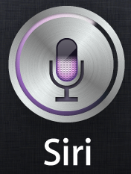


Voice recognition

Slide 6
2
Project overview
Data, Target, method

Slide 7

Data
REC
Using about 10-20 voice data
Record three times
By adjusting the length and height of the voice file
Securing the Number of Data

Slide 8

Data
Adjusting the length
Adjusting the height

Slide 9




Target
Hello
Hyeong won.
Hey siri.

Slide 10
Method
1
Collect voice data
2
Adjust voice data and secure data
3
Data preprocessing
4
Data training on neural network
5
Voice recognition
6
Result

Slide 11
3
Core technology
Hardware & Software, technology

Slide 12



Hardware & Software
or
Input voice data and output result
Data training & voice recognition

Slide 13
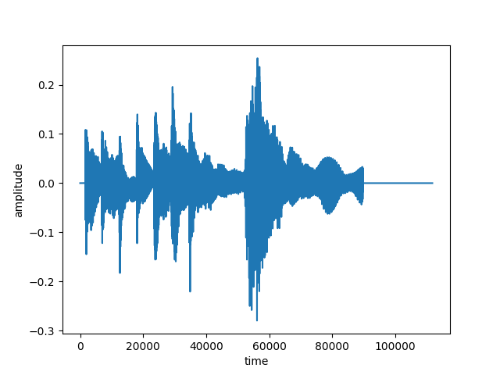
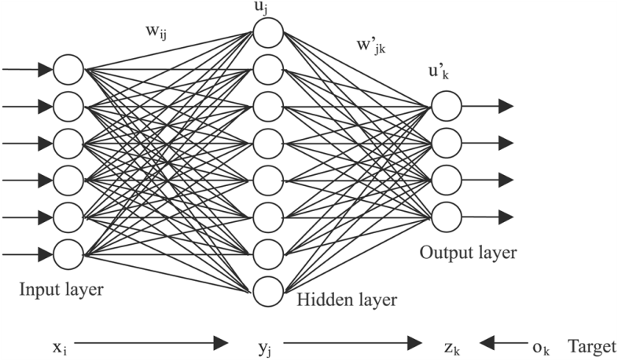
Technology
1
Librosa (python module)
2
DNN

Slide 14
4
Future plans
Plans

Slide 15
Plans
Collect data
Data training and reinforcement learning
Recognize voice and output correct result

Slide 16
Thank You.

